Slide 1
Science Guidance

Slide 2
Pendeen School Science Principles
A high-quality science education provides the foundations for understanding the world through the specific disciplines of biology, chemistry and physics. Science has changed our lives and is vital to the world’s future prosperity, and all pupils should be taught essential aspects of the knowledge, methods, processes and uses of science. Through building up a body of key foundational knowledge and concepts, pupils should be encouraged to recognise the power of rational explanation and develop a sense of excitement and curiosity about natural phenomena. They should be encouraged to understand how science can be used to explain what is occurring, predict how things will behave, and analyse causes.

Slide 3
Intent
At Pendeen our science learning broadly follows the National Curriculum. Where we engage children in real learning in carrying out investigations, where children are able to wonder and ponder.
Hands on learning enables children to visualise, discuss, predict and challenge each other’s learning, either inside or outside of the classroom.
To link learning with the class topics where ever possible and to provide a real context to their learning.
To provide time where children are free to explore and investigate and take their learning on further.
To provide children with the skills, equipment and good resources to implement their scientific learning.
Although science is a stand alone we try to link it across the curriculum where possible especially in writing
To provide wow days where science is at the heart of the learning, where children are able to work collaboratively across all key stages.
To make links with local feeder schools, where children are able to access their resources and where they are able to come into school and work alongside children of Pendeen.
At Pendeen we understand that science starts in the EYFS classroom where children learn through ‘The understanding of the world’, where children are exposed to scientific language, which is a stepping stone for future knowledge growth.
At Pendeen we work on the children learning two categories of knowledge ‘substantive’ and ‘disciplinary knowledge’. The first is based on the models and theories of science the second on scientific enquiry. These are carefully interwoven to build on subject knowledge.

Slide 4
Implementation
To allow children in EYFS to have the resources and time to wonder and ponder, both inside and out.
To provide regular good quality CPD, for Science Lead and other staff on a regular basis.
Science will be delivered in a system of lessons at the discretion of the teacher, depending on the nature of the class topic. Each topic will contain a minimum of 6 lessons.
Science and STEM days will allow for children to have their wow days, enabling different activities available across all key stages.
To make strong links with local feeder school where they are able to work with the children across all key stages, and allow the Key stage 2 to have access to science labs for lessons.
To provide stronger links with outside professionals that are able to support the class topic, or to provide experiences that cannot always be delivered in daily school timetable.

Slide 5
Impact
To provide as much outside learning as possible especially in the EYFS classroom.
EYFS to provide equipment and resources where children can wonder and ponder, and have time to develop and deepen their understanding of the world around them.
To provide good quality equipment that can be used across all key stages, and is maintained regularly.
Regular book scrutinises will take place where we can monitor the skill progression across the school.
Children will enjoy their wow days and be able to tell us about the science that has taken place.
Children will become more inquisitive about the world around them, and ask those enquiring questions.
Children will use science language in their everyday discussions, and use them in their writing.
Children will become more resilient in persevering in their tasks and activities and not having the fear of getting it wrong.

Slide 8
We follow the rolling programme to insure coverage and content is appropriate for age and stage across mixed age classes.
*We use the plan knowledge matrices from Y1-Y6 for core content. https://www.planassessment.com/plan-knowledge-matrices
Available on line with no login required
* We use Explorify to engage and encourage questioning, oracy and thinking about scientific context. https://explorify.wellcome.ac.uk/en/activities
All staff have their own individual login details
* We use Pzaz to support planning, teaching and assessment https://www.pzaz.online/
All teaching staff have login access and passwords
* We use TAPS assessment lesson plans for focused assessment https://pstt.org.uk/

Slide 9
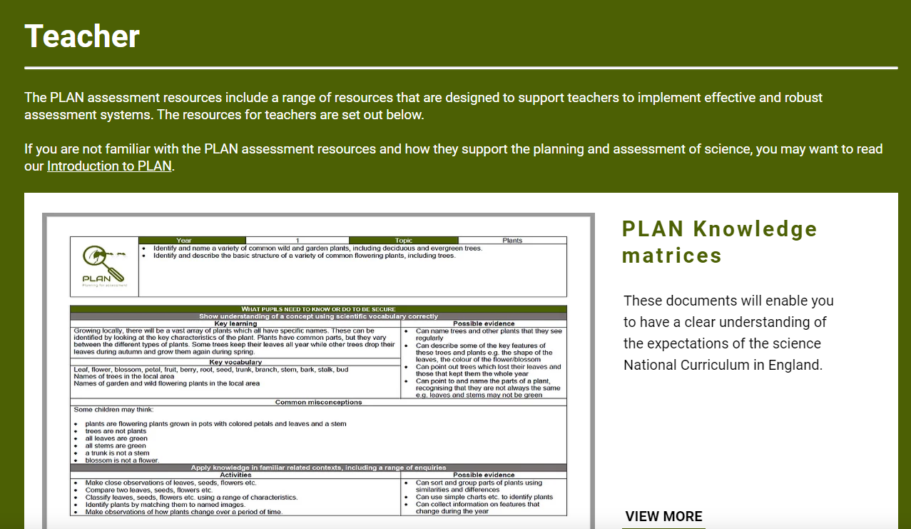
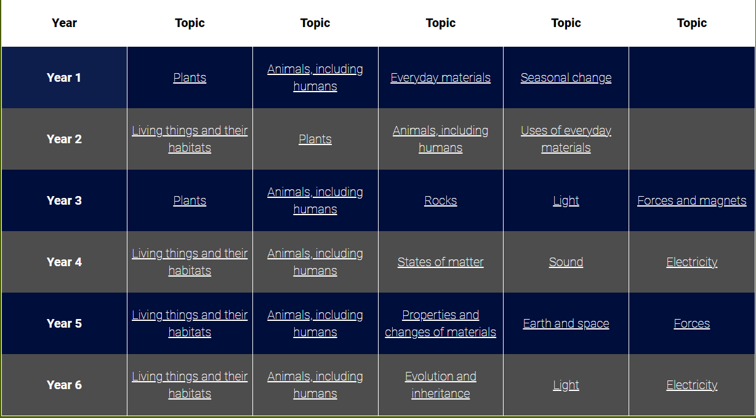
Animals, including humans (Y1) | PLAN (planassessment.com)
The matrices are used for all staff to check the
knowledge that is required for each taught topic.
It allows staff to check what children should already know
and what they will learn in each topic. It allows staff to see
what they will learn next as they move to the next year group.
This is especially important as Ofsted are very clear, learning
should remain in each year group and there should be a clear
divide between the year groups and topic coverage.
Have a look at the ones on your table and you can see how they can help with misconceptions, vocab. If you reach an end of a unit and you are not sure what the children know you can use some of the activities to assess.

Slide 10
Explorify
https://explorify.uk/en/activities/zoom-in-zoom-out/hooks-and-loops
There are a lot of different activates that you can use on Explorify, and each lesson will start with a quick tell me what
you know and why. This is a good chance for some oracy. I always ask certain children their thoughts as it can always be
the same child answering, and it is also good assessment tool as well.
You could always use it at the end of the lesson to see what the children have learnt, as another quick assessment tool.

