Slide 1
Pendeen Worship Assembly
Wendesday 21st September 2022

Slide 2
WELCOME

Slide 3
CONSENT???
Have you heard of Consent ?
Can anyone say what it means?
It can be difficult to understand, especially as decisions and rules are made all the time for children but often for adults too
Consent is generally about freely agreeing
to a suggestion by someone else
Lets explore this further….

Slide 4
RULES?
What type of rules can you think of?
Rules we’re used to??
Are all rules written down?
Are there different rules for girls and boys?
Notes:
The age of criminal responsibility is 10 in England, Wales and Northern Ireland. That means in Law you are responsible for your actions after the age of 10. So its important for you to know and understand your responsibilities early on.
Think about rules and if we always understand what they are?

Slide 5
What is safe and unsafe?
Where is your safe place?
How do you feel when your safe?
What situations might you feel unsafe?
How does this make you feel?
Notes:
Have a think about the times when you may feel safe and unsafe….

Slide 6
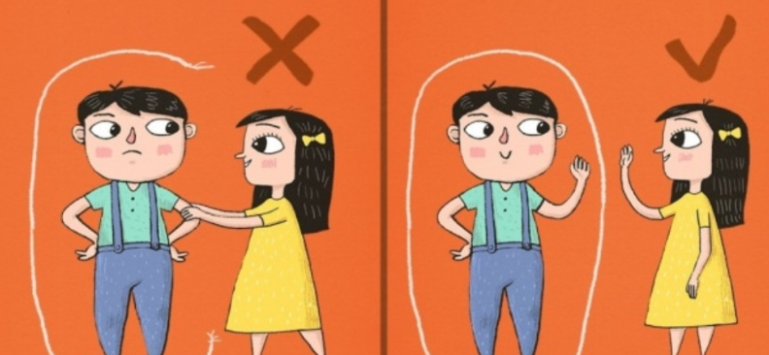
CONSENT?
Consent is part of any healthy relationship – our class mates, friends, family & teachers
What does consent mean for me?
Everyday Consent
Notes:
Consent is when a person freely gives their permission or agrees to something, after having carefully thought about whether or not they want to do something. This decision should have been made without that person being: pressured or bullied, or made to feel stupid.

Slide 7
What are your Rights? You have the right to feel safe and say No when you don’t What are your Responsibilities? Always ASK first….
So Consent is about Feeling safe when we agree to something

Slide 8
KEY POINTS
We all have rights and responsibilities for ourselves and to others
We have the right to feel safe all of the time
Healthy relationships feel safe and comfortable
It’s important to remember that you always have a right to say no even when you have already said yes
If others don’t actually say no it doesn’t mean they are saying yes

Slide 9
HOW TO FIND YOUR SCHOOL NURSES
IF YOU THINK A SCHOOL NURSE CAN HELP YOU WITH ANY HEALTH THINGS ASK YOUR TEACHER OR PARENT TO CONTACT US
Phone: 01872 322779
Email: hvsnadvice@Cornwall.gov.uk
Web Info: www.cornwall.gov.uk/schoolnursing
WE ARE THE SCHOOL NURSE TEAM FOR YOUR SCHOOL
TRACEY, CARA , DEBBIE & CHARLEY
JANE, DAVID & RACHEL

Slide 10
NSPCC PANTS LINK https://www.nspcc.org.uk/keeping-children-safe/support-for-parents/pants-underwear-rule/ children-safets-underwear-rule/

Slide 11
The Lord’s Prayer
Our Father, which art in heaven,
Hallowed be thy Name.
Thy Kingdom come.
Thy will be done on earth, as it is in heaven.
Give us this day our daily bread.
And forgive us our trespasses,
As we forgive them that trespass against us.
And lead us not into temptation, but deliver us from evil.
For thine is the kingdom,
The power, and the glory,
For ever and ever. Amen.

