Slide 1
Pendeen Worship Assembly
Friday 9th September

Slide 2
WELCOME

Slide 3
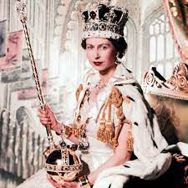
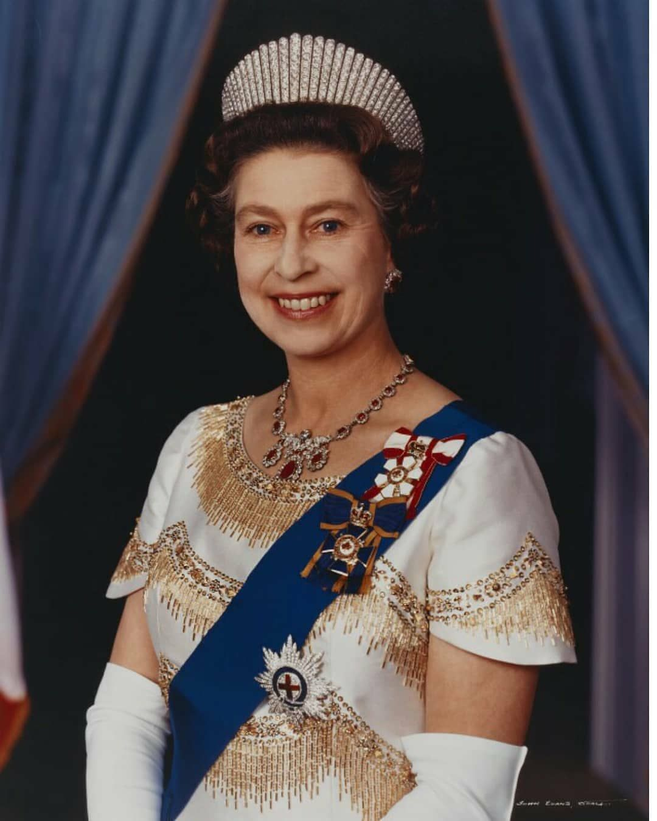
HRH Queen Elizabeth 2nd 21 April 1926 to 8th September 2022

Slide 4
Dear God
We gather here today to remember Her Majesty the Queen.
We give thanks for her long life, and for all the ways she loved and served those in her care.
We bring you our sadness for what we have lost;
Our gratitude for what we remember and cherish;
And our wondering about what is to yet to come.
Thank you for the comfort, peace and hope you bring us.
Amen

Slide 5
Excellence - particularly good work/effort, striving to do their best.
Politeness - displaying good manners, putting others first.
Co-operation – working with others, friendship, displaying a caring attitude towards others, kindness, happiness.
Determination - Staying on task, challenge, growth, patience, resilience
Courage – taking risks and going out of a comfort zone
Assertiveness – being able to communicate effectively, knowing when and how to communicate in certain ways
Responsibility – taking ownership, moral, family, community
Honesty – Fairness, saying sorry
Respect – Diversity, listening, understanding, tolerance

Slide 6
Choose your school councillors on who will model and promote
Excellence - particularly good work/effort, striving to do their best.
Politeness - displaying good manners, putting others first.
Co-operation – working with others, friendship, displaying a caring attitude towards others, kindness, happiness.
Determination - Staying on task, challenge, growth, patience, resilience
Courage – taking risks and going out of a comfort zone
Assertiveness – being able to communicate effectively, knowing when and how to communicate in certain ways
Responsibility – taking ownership, moral, family, community
Honesty – Fairness, saying sorry
Respect – Diversity, listening, understanding, tolerance
Councillors make real decisions – Millie the Dog, Beach Day, Chickens

Slide 7
HT Award
Marcus - Excellence

Slide 8
PENDEEN CAN! we CAN be Caring towards ourselves and others. We CAN Aspire to be the best that we can be. We CAN Nurture ourselves and others to achieve our highest potential and look after ourselves and others.
PENDEEN CAN!
PENDEEN CAN!
PENDEEN CAN!
PENDEEN CAN!
PENDEEN CAN!

Slide 9
The Lord’s Prayer
Our Father, which art in heaven,
Hallowed be thy Name.
Thy Kingdom come.
Thy will be done on earth, as it is in heaven.
Give us this day our daily bread.
And forgive us our trespasses,
As we forgive them that trespass against us.
And lead us not into temptation, but deliver us from evil.
For thine is the kingdom,
The power, and the glory,
For ever and ever. Amen.

