Slide 1
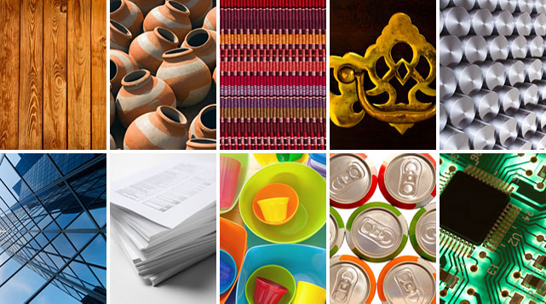
1.4 An Introduction to Materials
Chemistry – Everyday Materials

Slide 2
https://explorify.uk/en/activities/zoom-in-zoom-out/fuzzy-friend
Lesson 1: To be able to identify materials

Slide 3
plastic
wood
rock
glass
material
metal
hard
solid
soft
natural
property
Man-made

Slide 4
What Am I going to learn today?
Can I identify materials?
Can I identify the materials from which objects are made?

Slide 5
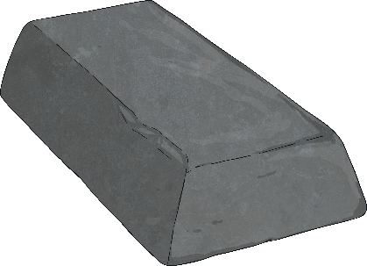
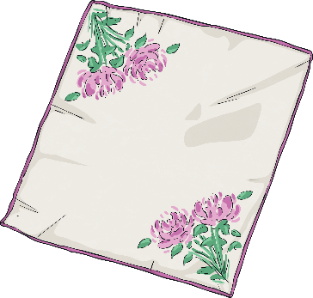
Materials
We use wood, metal, plastic, glass and fabric to make most everyday objects.
Different materials have different properties.
Materials can be natural or humanly-constructed.
Here are a few facts about some materials…

Slide 6
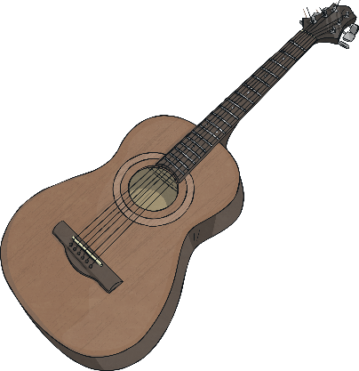
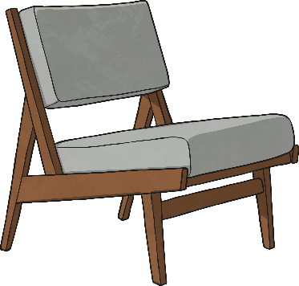
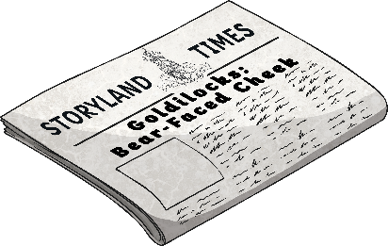
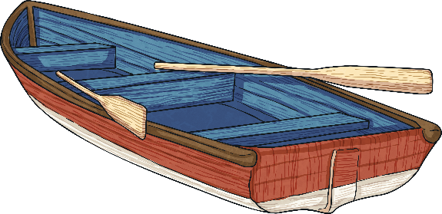
Wood
Wood is a natural material. It comes from trees.
A few things made from wood are:
furniture
boats
instruments
paper
Wood is used as it can be carved in to any shape, is strong and has a very nice appearance.

Slide 7
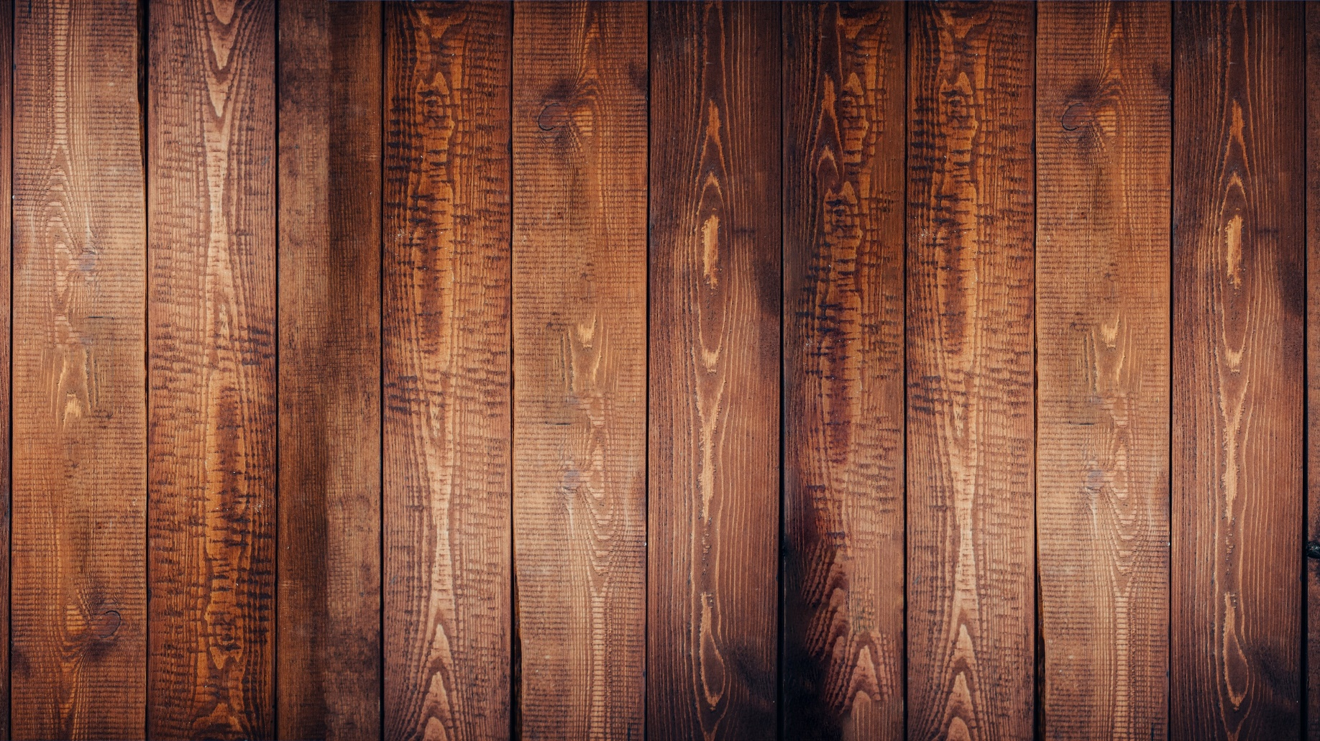
wood

Slide 8
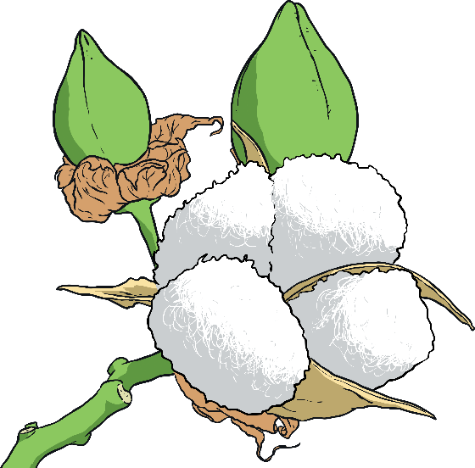
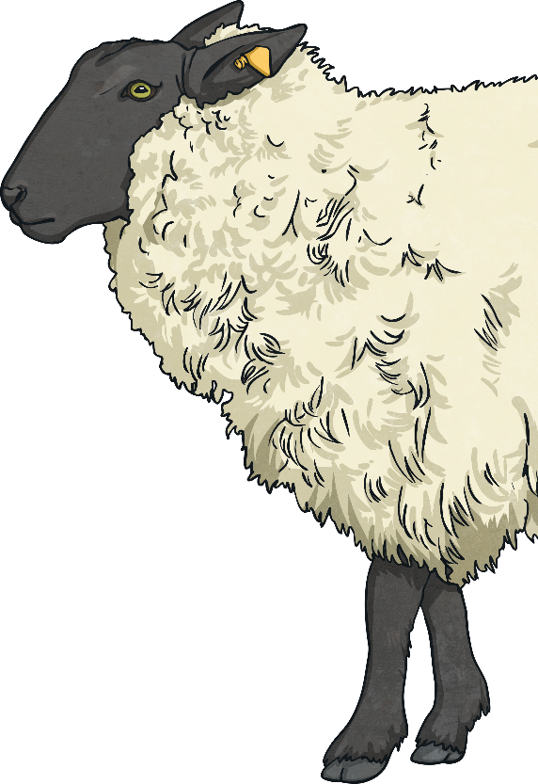
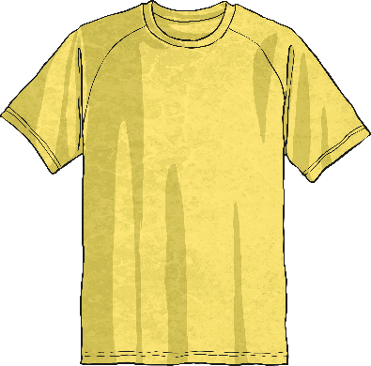
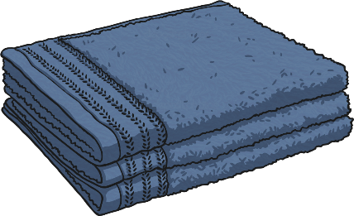
Fabric
Fabric comes from plants and animals.
A few things made from fabric are:
curtains
clothes
towels
Fabric is used as it is very light, warm, soft and quite easy to produce and sew.

Slide 9
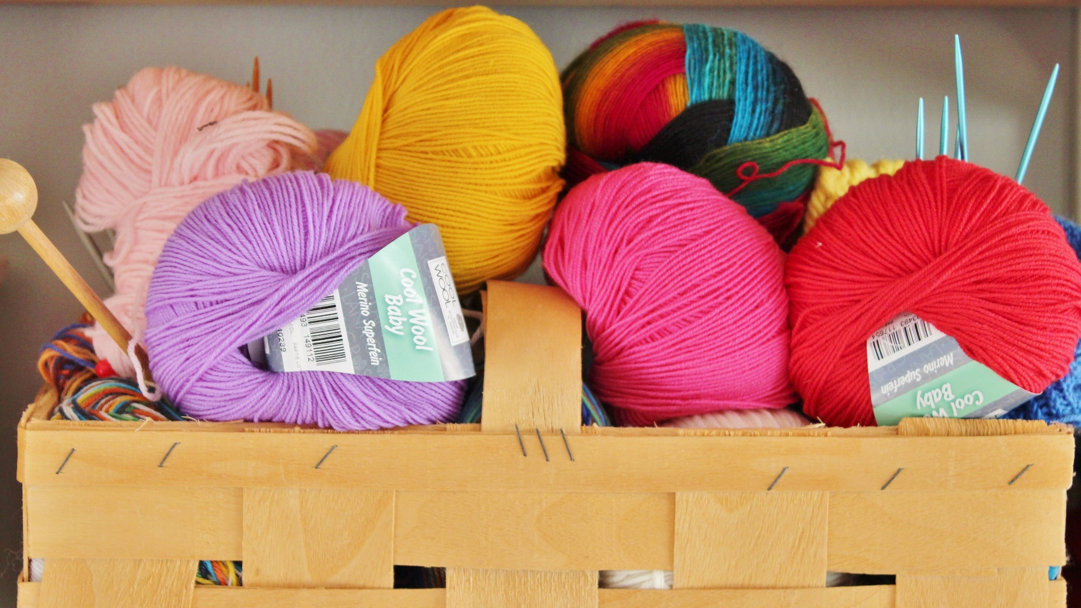
wool

Slide 10
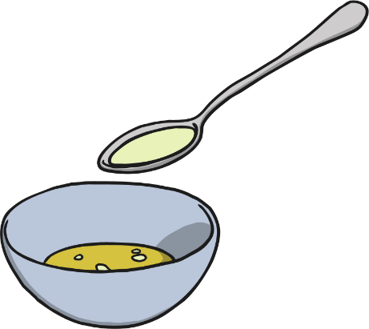
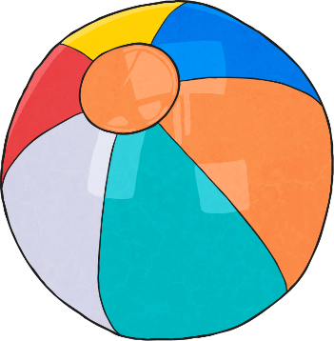
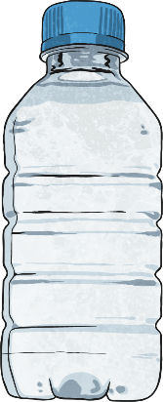
Plastic
Plastics are humanly-constructed, mostly from oil.
A few things made from plastic are:
balls
bottles
carrier bags
Plastic is used as it can be made to be flexible, hard, rough or smooth. It is also very cheap to produce and easily washable.

Slide 11
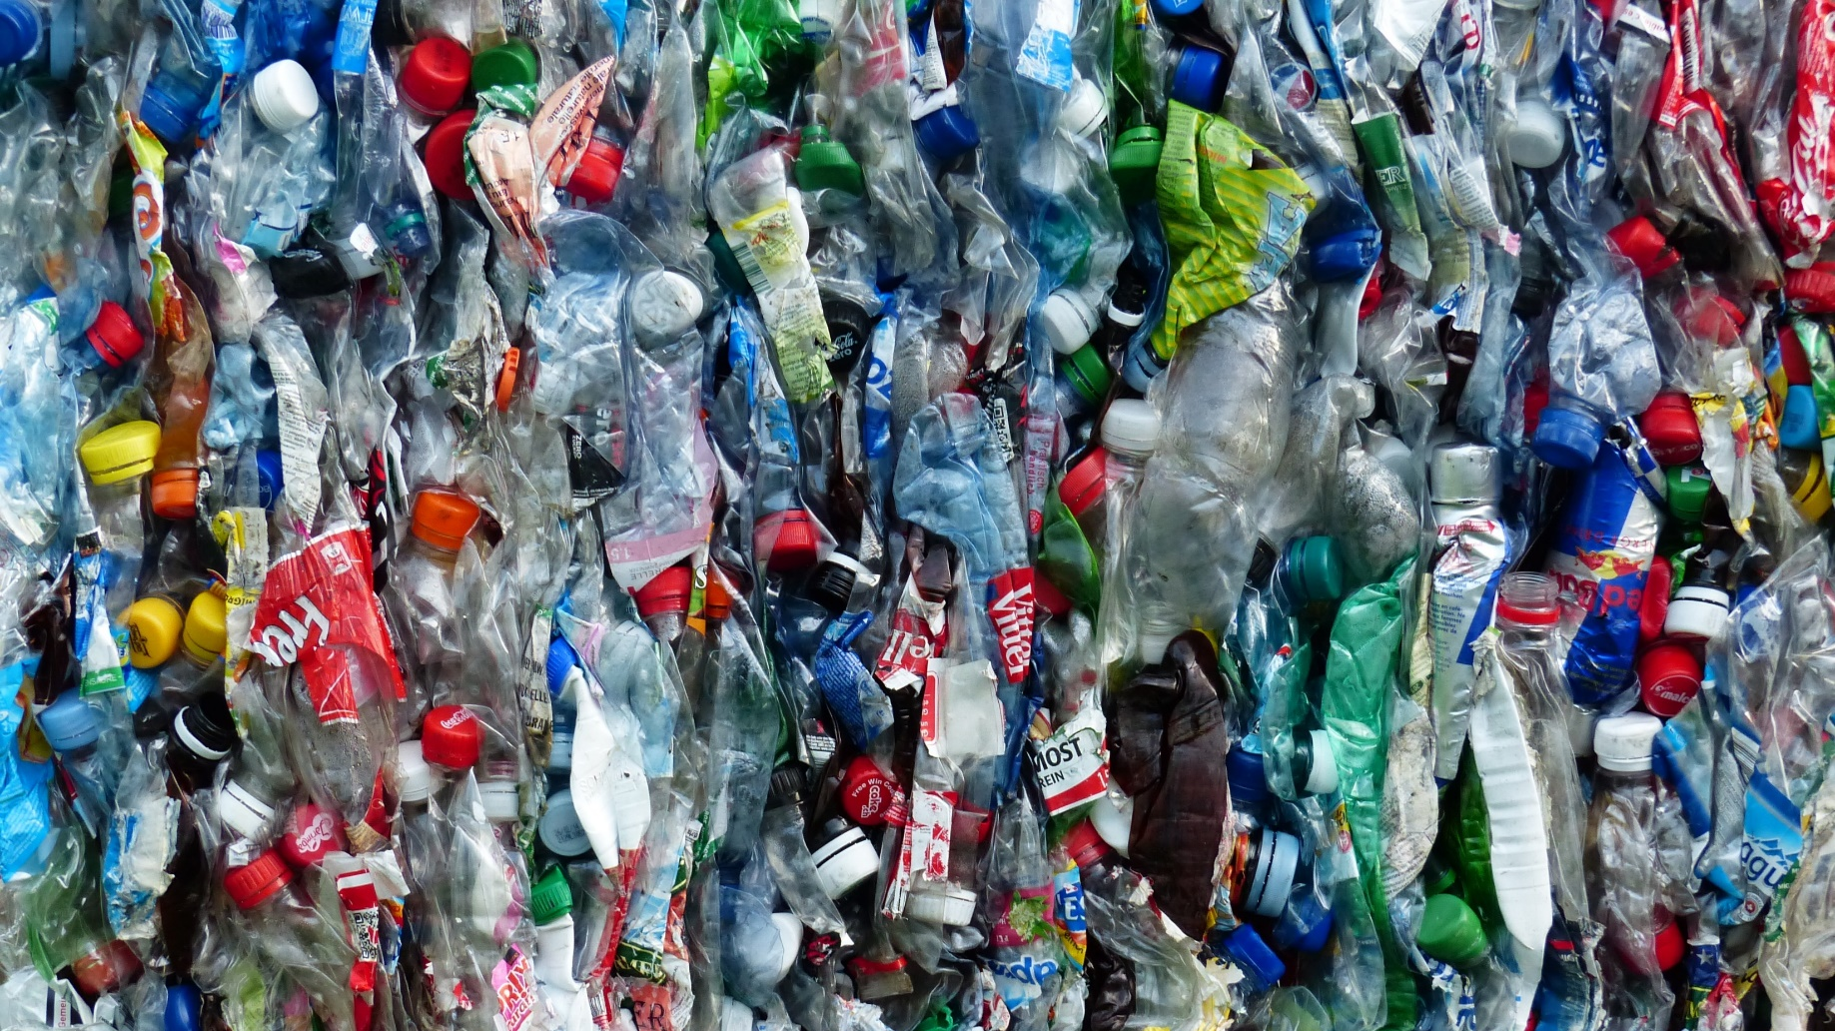
plastic

Slide 12
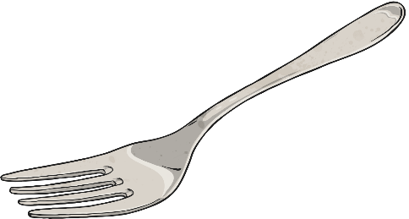
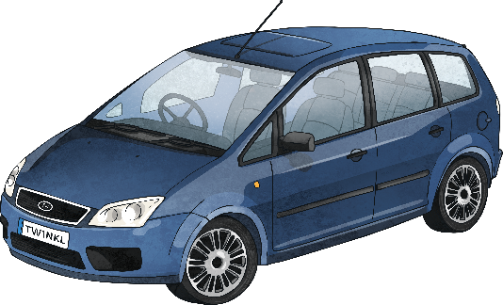
Metal
Metals are made from rocks. The rocks are dug up and taken to a factory where they are heated and processed into metal.
A few things made from metal are:
jewellery
cutlery
cars
Metal is used as it is strong, hard, smooth and easily washable.

Slide 13
metal

Slide 14
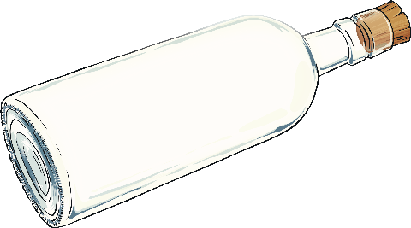
Glass
Glass is made from very fine sand. It is heated until it melts.
A few things made from glass are:
bottles
light bulbs
glasses
Glass is used as it is strong, hard, smooth, easily washable and transparent.

Slide 15
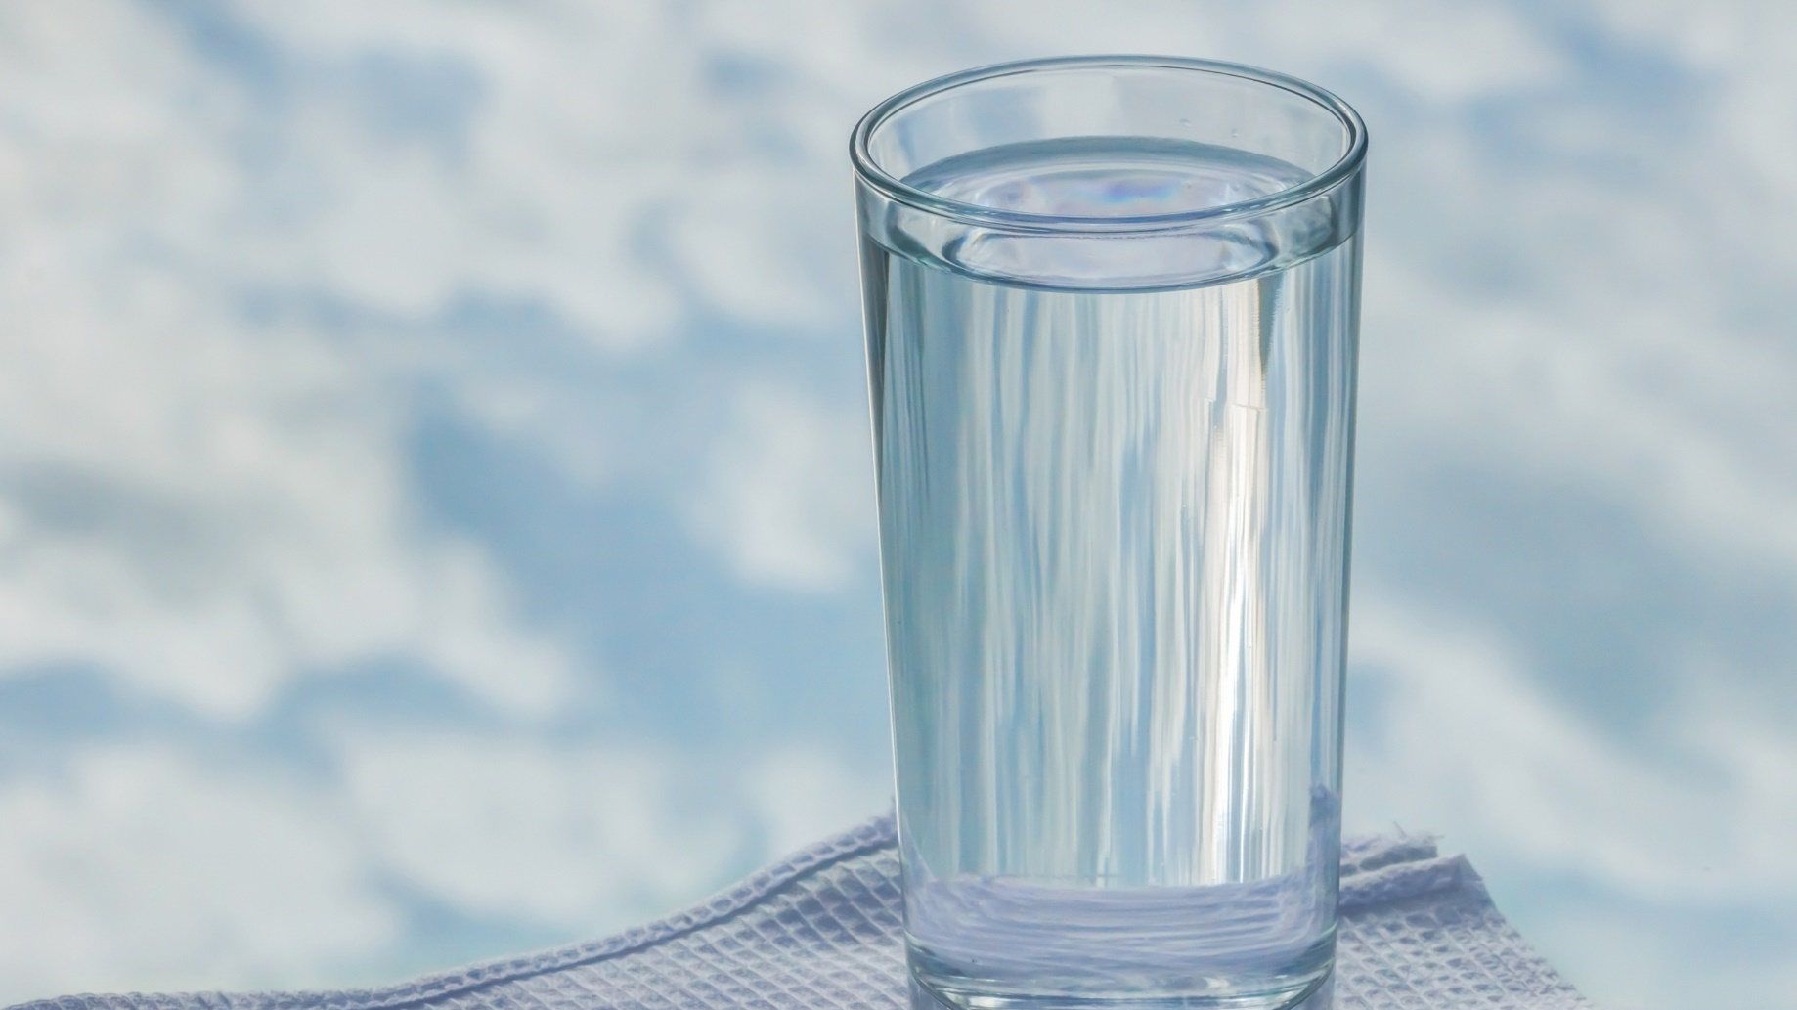
glass

Slide 16
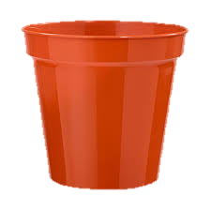
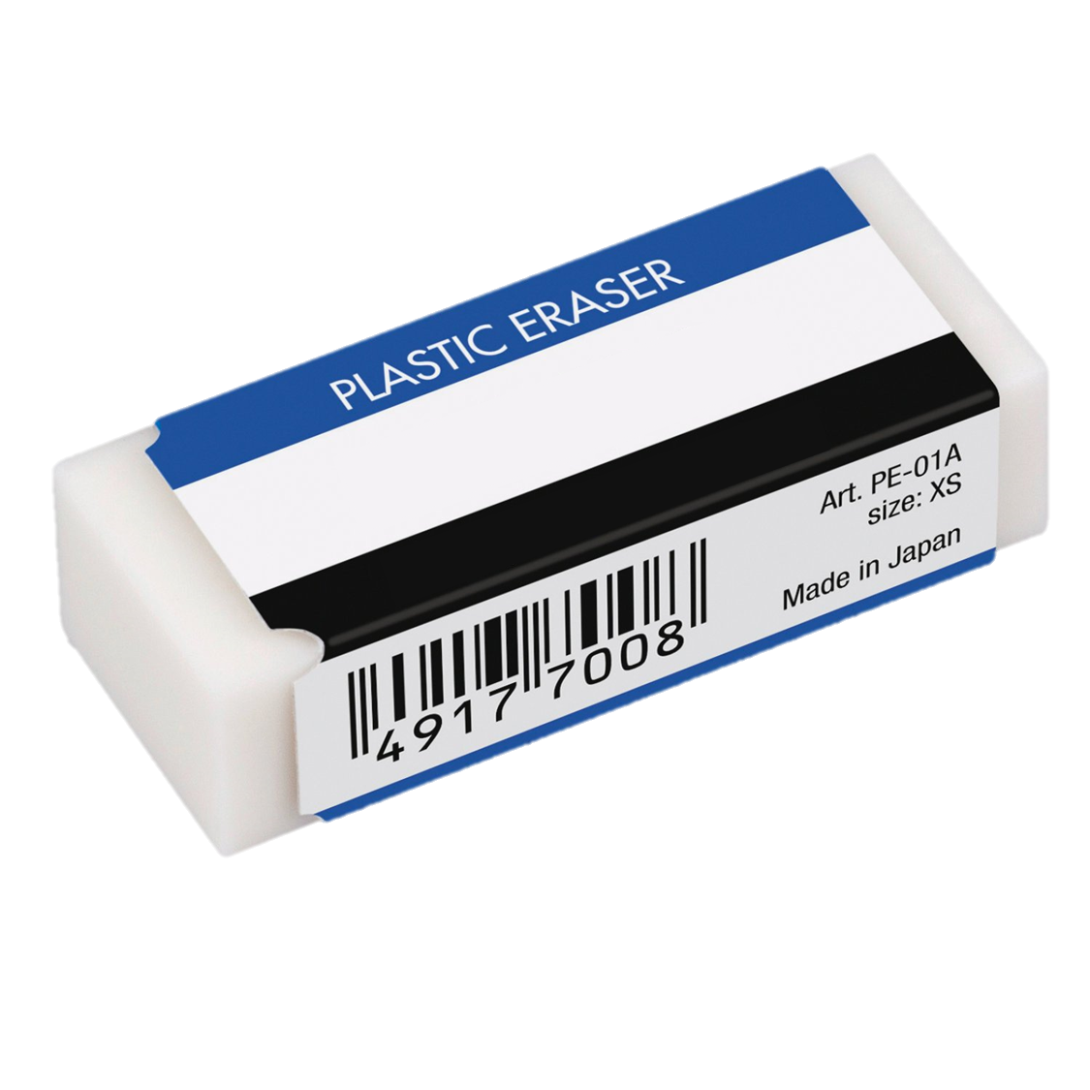
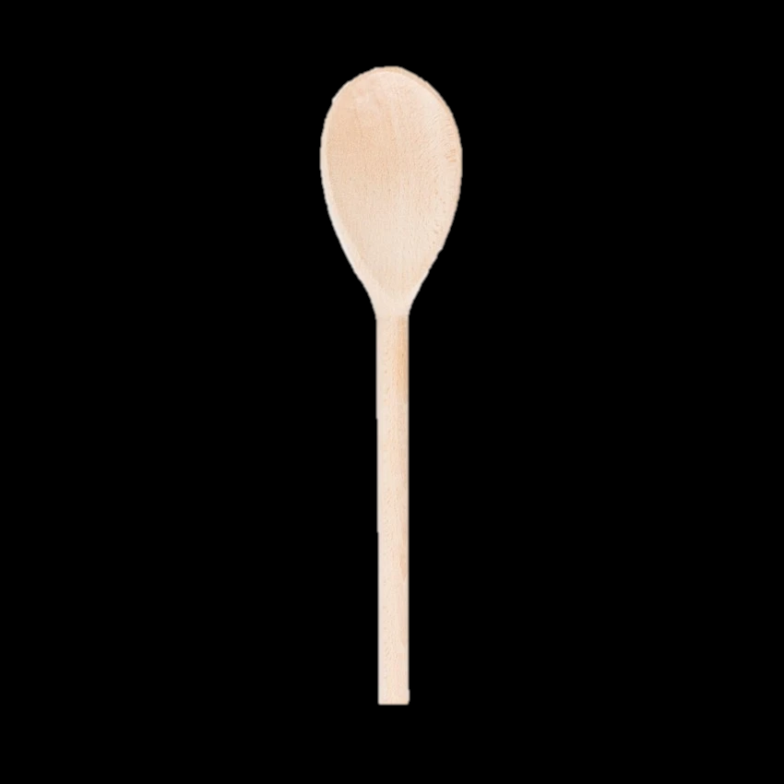
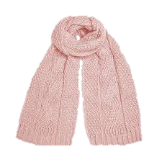
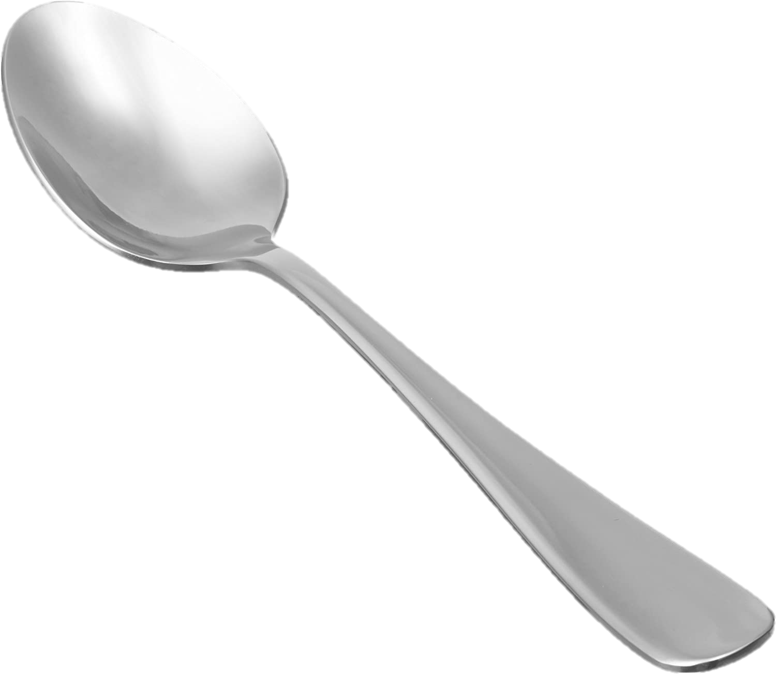
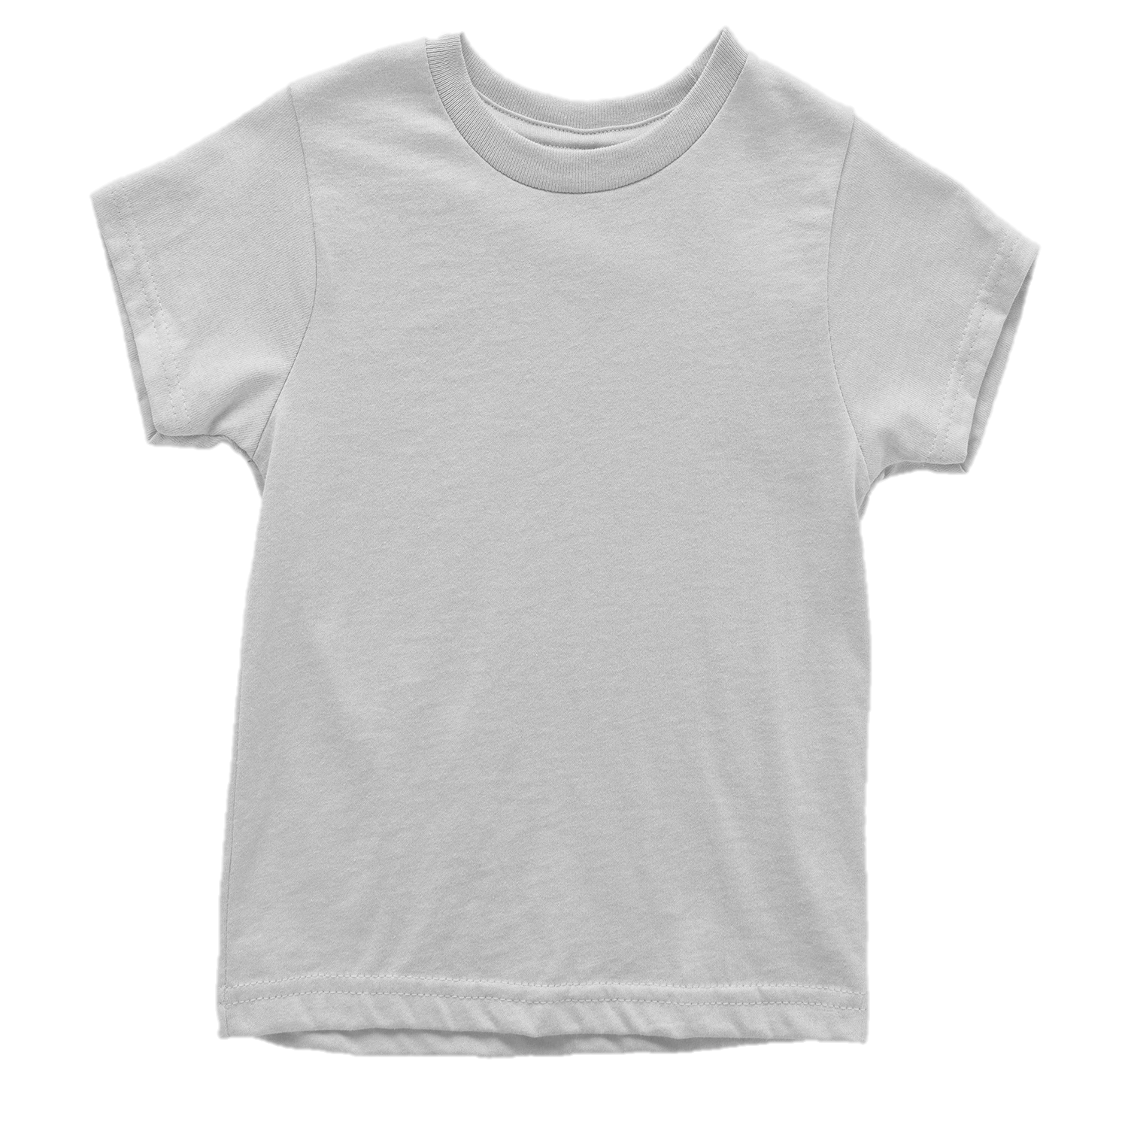
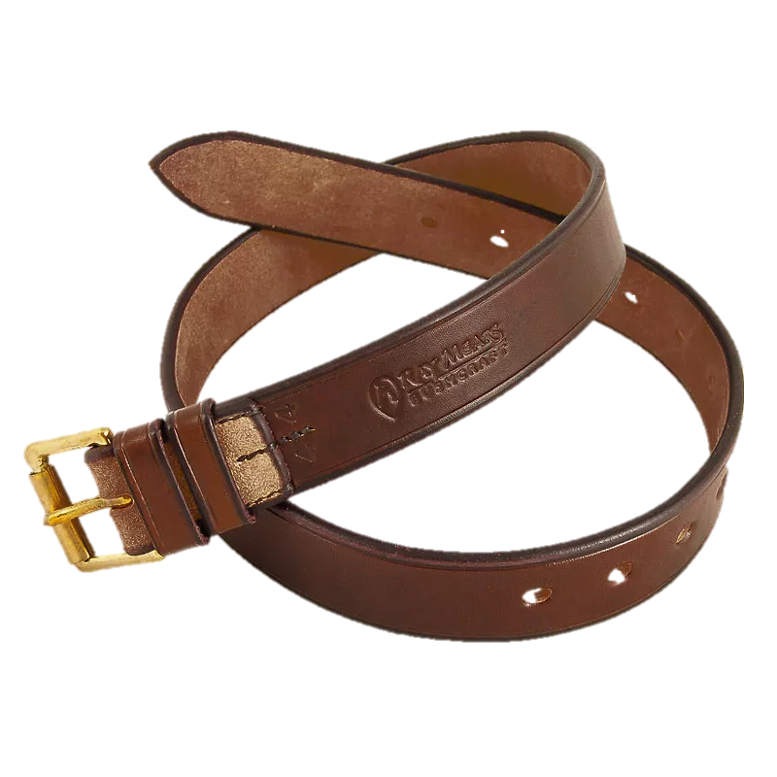
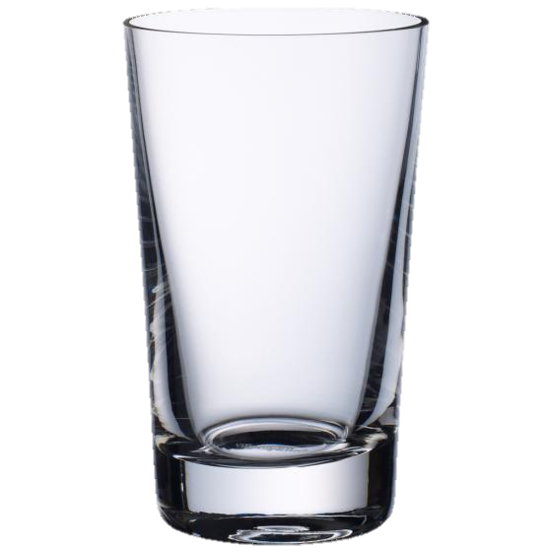
Types of Materials
Look at the objects and describe what they are made of.

Slide 17
Types of Materials
Today there are lots of objects on the tables. In your groups I would like you to have a go at labelling them
And telling us what they are made from.
Please be careful as some of the objects are heavy and could hurt someone, or some could become sharp
and cut someone.
When we have had a go at looking at the materials on the table, we will go outside and see what materials
we can find and label them.
We will take some photos and put these in our memory books and working wall.

Slide 18
Name me one material you have seen today.
Name me an object we can make from plastic.
3. Name me the 5 senses.

Slide 19
https://explorify.uk/en/activities/listen-what-can-you-hear/all-crushed-up
Lesson 2:To be able identify the materials from which objects are made

Slide 20
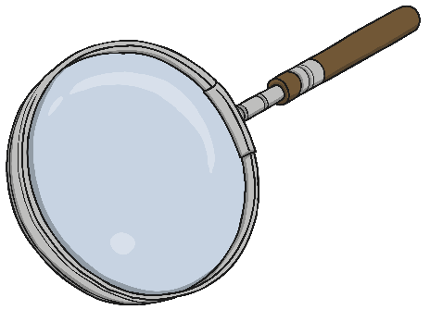
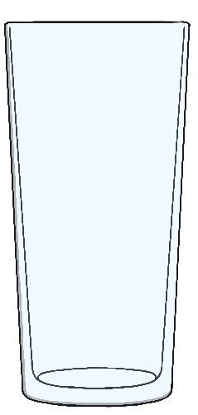
Object Challenge Answers
What do these objects have in common?
These objects are all made from glass!

Slide 21
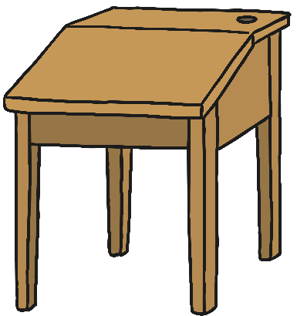
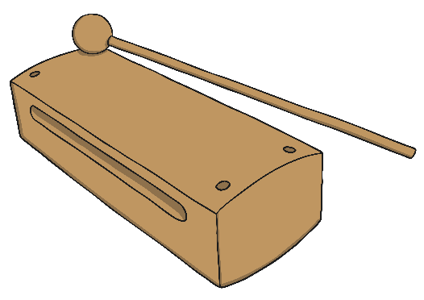
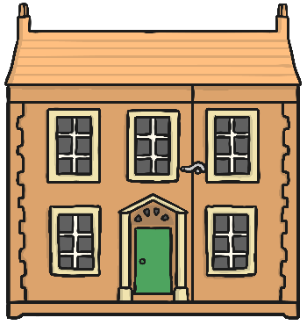
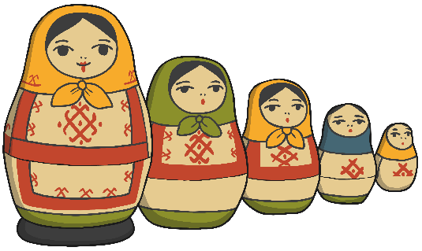
Object Challenge Answers
These objects are all made from wood!
What do these objects have in common?

Slide 22
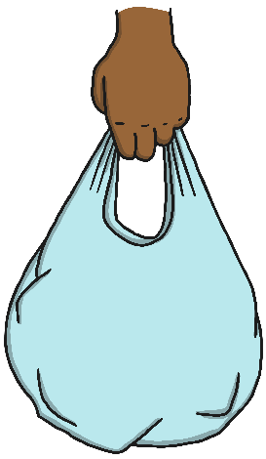
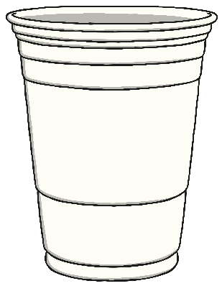
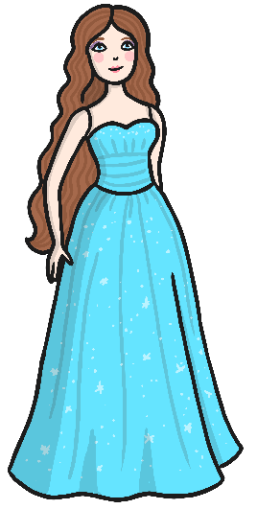
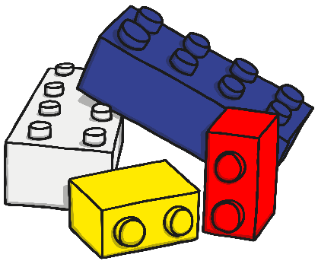
Object Challenge Answers
What do these objects have in common?
These objects are all made from plastic!

Slide 23
Material Challenge
What objects can you see in this picture?
What materials do you think these objects are made from?
How do you know?
glass
wood
start
Time up!
Photo courtesy of Radiobrain_@flickr.com) - granted under creative commons licence – attribution
Notes:
Click the slide to start the minute timer

Slide 24
Material Challenge
What material is this pencil sharpener made from?
How do you know?
Is it made from one material?
metal
plastic
start
Time up!
Photo courtesy of quinnanya@flickr.com) - granted under creative commons licence – attribution
Notes:
Click the slide to start the minute timer

Slide 25
Material Challenge
plastic
What materials are these glasses made from?
How do you know?
glass
start
Time up!
Photo courtesy of WillVision@flickr.com) - granted under creative commons licence – attribution
Notes:
Click the slide to start the minute timer

Slide 26
Odd One Out
Which of these do you think is the odd one out? Why?
Photo courtesy of Rev Stani@flickr.com, Richard-Gi@flickr.com, CARLISLEHVACi@flickr.com and Horrortaxi@flickr.com) - granted under creative commons licence – attribution

Slide 27
On your table today there are some objects. I would like you to have a look at the objects and then decide
what the objects are made from. Once you have done this you will need to tick the materials on the sheet.

Slide 28
What materials are there in a window?
Can a spoon be made out of chocolate?
3. What is an invertebrate?

Slide 29
https://explorify.uk/en/activities/have-you-ever/stretched-a-hair-band-or-an-elastic-band-too-much
Lesson 3: To be able describe the properties of materials

Slide 30
hard
soft
twist
bendy
scrunch
solid
Man-made
natural
property
squishy
stretchy

Slide 31
Here are some more words that we can use to describe the different materials.
hard
soft
stretchy
stiff
shiny
dull
rough
smooth
bendy
not bendy
waterproof
not waterproof
absorbent
not absorbent
opaque
transparent
Notes:
Click on slide to start minute timer

Slide 32
Types of Materials
Today I would like to test the property of the materials out.
You will need to pick up the object and see what you can do with it.
Can you twist it?
Can you bend it?
Can you stretch it?
When you have tested the object you will need to tick the correct boxes.

Slide 33
What is a property of a material?
Name an object that can be made from metal?
3. Name a mammal?

Slide 34
https://explorify.uk/en/activities/whats-going-on/spinning-a-yarn
Lesson 4 and 5: To be able to investigate the physical properties of materials

Slide 35
repel
plastic
wood
rock
absorbent
Water proof
glass
material
metal
hard
solid
soft
natural
property
Man-made

Slide 36
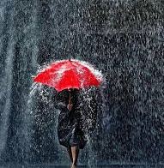
What Am I going to learn today?
Can I link the physical features of materials to their properties?
Can I make suggestions for materials to make objects based on properties?

Slide 37
Materials Song
Listen to the song:
www.youtube.com/watch?v=_oK8CRa2rXY

Slide 38
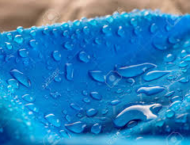
Waterproof Materials
Some materials do not let water go through them: they are called waterproof materials.
Other materials have tiny holes that water can flow into: they are called absorbent materials.

Slide 39
Investigation
For the next two lessons we are going to test the properties of different materials.
We need to find out which materials are waterproof so Teddy can have a new umbrella.
What do I mean by waterproof?
How will I know if it is waterproof?
What materials do you think will make the best umbrella and why?

Slide 40
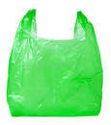
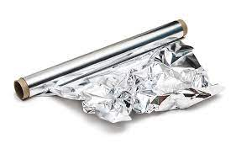
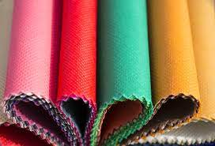
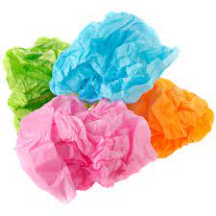
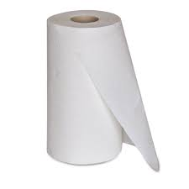
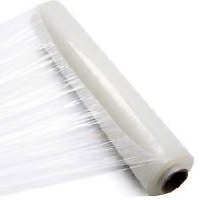
Predict
First we need to predict what material we think will be the best. I am going to give you some to choose
From and then you are going to write the word in your speech bubble.
Plastic bag
Tin foil
fabric
Tissue paper
Kitchen roll
Cling film

Slide 41
Investigation
Now we are going to test the materials. We will put the material we are using over the plastic cup and then
We will slowly drop water onto the object and see which are absorbent and which are waterproof.
We may need to wait and see if the material soaks up the water. Remember if we were out in the rain the
Umbrella would be up for a long-time.
We have all afternoon to complete this experiment. You will need to work with your table partner. You must
Share the putting the material on the cup and adding the water.

Slide 42
What does absorbent mean?
What is opaque?
3. Name a property of wood?

Slide 43
https://explorify.uk/en/activities/listen-what-can-you-hear/material-world
Lesson 6: To be able to design an underwater house.

Slide 44
plastic
wood
rock
glass
material
metal
hard
solid
soft
natural
property
Man-made

Slide 45
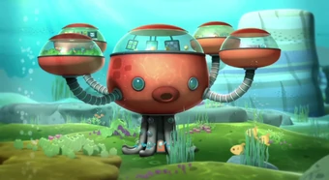
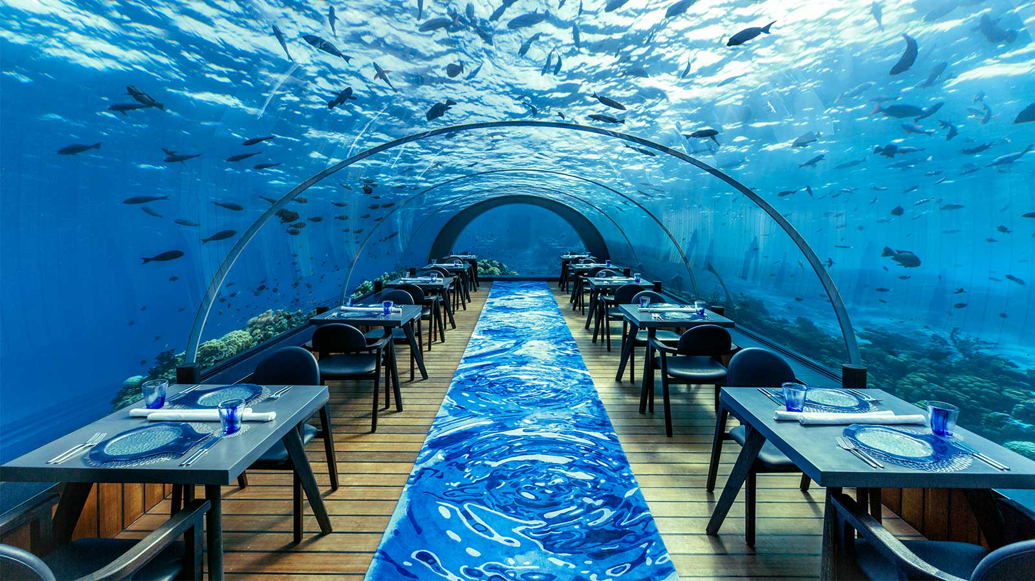
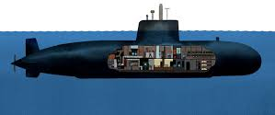
Bottom of the Sea Base
Design an undersea house!

Slide 46
Today we are going to design an underwater house.
We need to think carefully about the materials we will need on the outside. The shape and how you
would live in it.
If you need windows what are they going to made out of?
Will it need to move and if so will it need to float?
Like in the picture will you have separate pods for the different rooms in your house.
We have all afternoon to finish this off. You will need to draw it and then label the materials before
You colour it in.
Th picture needs to fill the whole page and be very clear.

